Slide 1
Course : 0553T / Multimedia System
Year : 2015
CONTENT AND TALENT
Session 10

Slide 2
OUTLINE
Acquiring Content
Ownership of Content Created for A Project
Acquiring Talent

Slide 3
Acquiring Content
Content
  Is the information and material that forms the heart of your project.
  Can be any and all of the elements of multimedia.
  Can have low and high production value.
  Content will have high production value if :
    Hire professional team to shoot and digitize

Slide 4
Acquiring Content
Content acquisition :
  Can be one of the most expensive and time consuming task in organizing a multimedia project.
  Be sure to plan ahead , allocating sufficient time and money for this task.

Slide 5
Acquiring Content
Using Content Created by Others
  When use other’s content in a broadcast or reproduction , should be granted to its creator
  Electronic rights :
    The rights to publish a work in a computer-based storage and delivery medium such as on a DVD or on the Web.

Slide 6
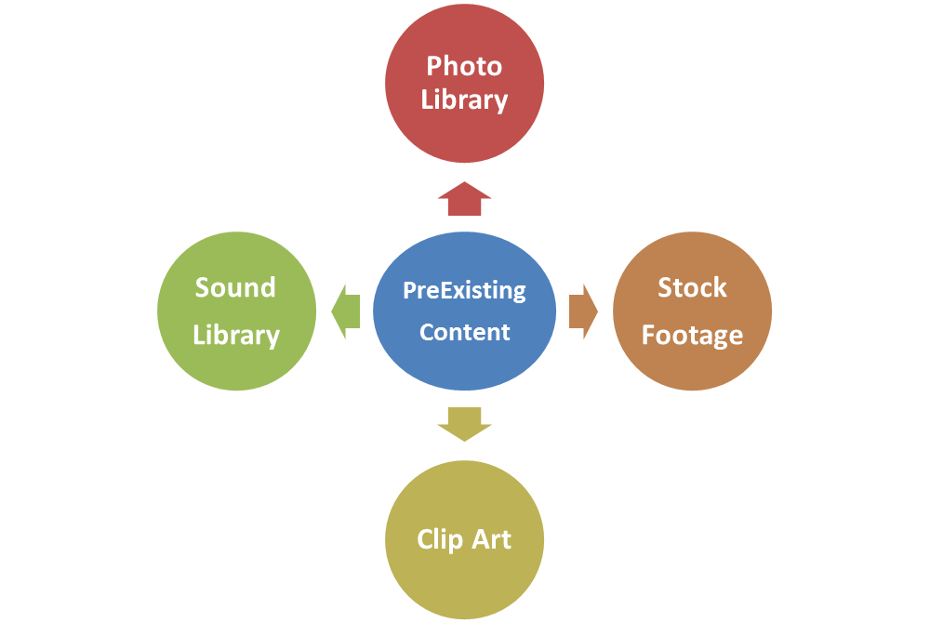
Acquiring Content
Using Content Created by Others
  Locating Preexisting Content

Slide 7
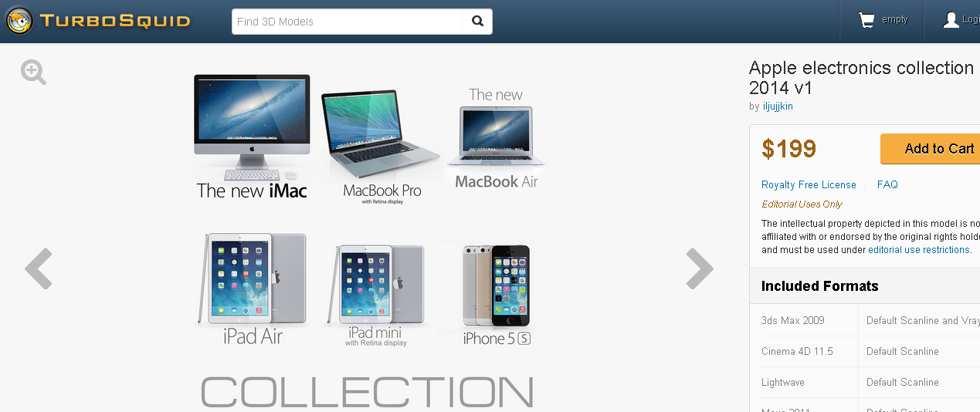
Acquiring Content
Example : download content from www.turbosquid.com

Slide 8
Acquiring Content
Source of Contents both copyrighted or public domain :
  The National Archives of United States
    www.archives.gov
  The National Archives of United Kingdom
    www.nationalarchives.gov.uk
  The Library of Congress
    www.loc.gov

Slide 9
Acquiring Content
  Copyrights
    Law governing copyright vary from country to country
    Example copyrights in the United States :
      Copyrights protection applied to “original works of authorship fixed in any tangible medium of expression”.

Slide 10
Acquiring Content
  Digital Rights Managements (DRM)
    Various rights management technologies
      FairPlay -> used in Apple
      Microsoft Windows Media Rights Manager -> used in Microsoft Windows
      The Association of American Publishers is promoting DRM methodologies to protecting unauthorized copying of e-books.

Slide 11
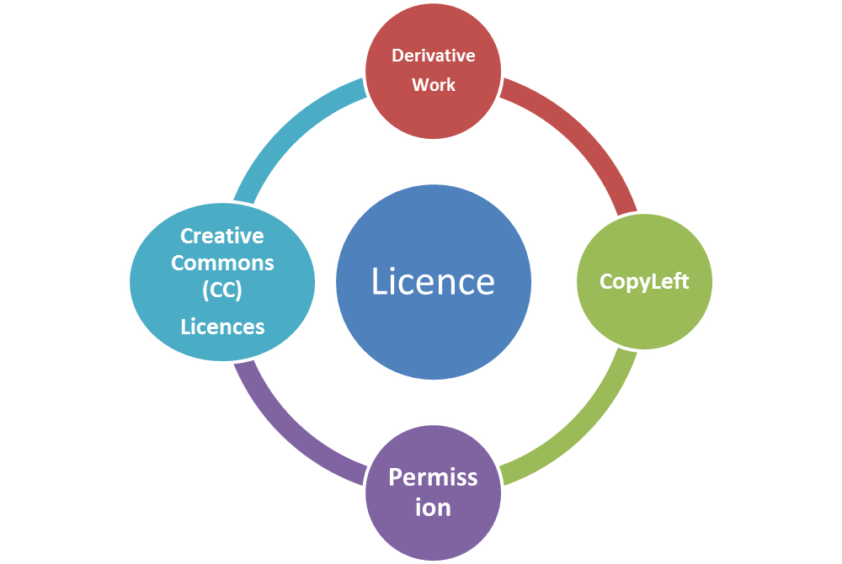
Acquiring Content
  Obtaining Rights
    License the rights to use copyrighted material before

Slide 12


Acquiring Content
  Derivative Work
    A tiny portion of an image owned by someone else and the original is no longer recognizable.
Who owns the resulting image ??
The original photograph
by Mark Newman
The image was clipped and
manipulated for use in multimedia project

Slide 13
Acquiring Content
  Permission
    Must be obtained to use copyrighted text.
    Permission to reprint copyrighted text material.
  Copyleft
    Antipodal to copyright
    Use the copyright laws themselves to remove traditional copyright protections from a work and offer that work with legal and unlimited permission clearly granted to freely copy, modify, transform, or distributed the work.

Slide 14
Acquiring Content
  Copyleft
    In software world, GNU ( General Public Licence) is intended to guarantee your freedom to share and change all version of a program.
  Creative Common (CC) Licences
    Grant specific rights to reuse and distribute media.

Slide 15
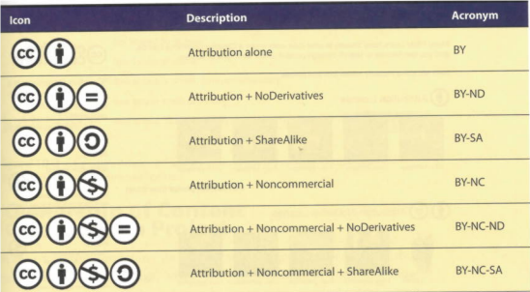
Acquiring Content
The six most commonly used Creative Common Licenses

Slide 16
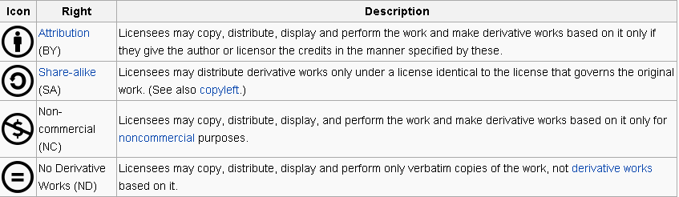
Acquiring Content
Conditions Under which a Creative Common Licence may be granted
(http:en.wikipedia.org/wiki/creative_common_license)

Slide 17
Ownership of Content
In general
  You can own the copyright when creating a project single-handedly for yourself.
  The ownership of a project created by employees in the course of their employment belongs solely to the employer if the work fits the requirement of “work made for hire”.
  Work made for hire :
    Work made by an employee as part of his or her job for an employer.

Slide 18
Acquiring Talent
Getting the perfect actor, model or narrator’s voice is critical.
In USA, there is SAG-AFTRA that provide professional voice-over talent and actors.
If your talent is nonunion (a co-worker, student actor, waitress, be sure to have the person sign a release form. This form grants to you certain permissions and specifies the terms under which you can use the material you make during a recording session.

Slide 19
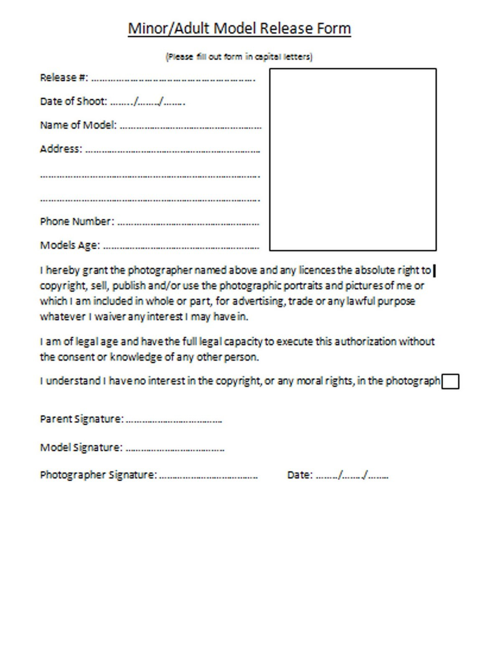
Release Form Example (every country may vary, depend regulation)

Slide 20
Supporting Materials
http://www.mmmlaw.com/media-room/publications/articles/negotiating-multimedia-agreements-issues-associated-with-acquiring-multiple-rights-from-multiple-parties

Slide 21
Exercise
List ten different kinds of content that can be used to develop a multimedia project!
List the source that can get free content in the public domain!

